Slide 1
Safer Internet project
Srednja škola Delnice
Delnice High School

Slide 2
location
Gorski kotar – northwest
40 km near biggest Croatian harbour Rijeka
100 km near Croatian capitol Zagreb
Near the state border with Republic of Slovenia

Slide 3
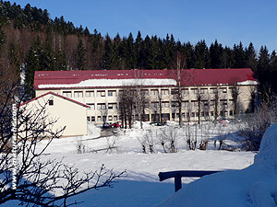
Srednja škola Delnice, spring 2015.

Slide 4
Delnice High School
220 students
48 employees
Mountain region: Gorski kotar (Horticus diabolicus – devil’s garden)
program
General program secondary school
4 years
program
Economist
4 years
program
Automechanic
Carpenter
3 years

Slide 5
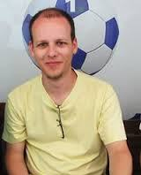
Project leaders
Jasminka Lisac – Croatian language teacher
Branka Mihajlović – Math teacher
Davor Pleše – English language teacher

Slide 6
Our motivation - lifelong learning
to create something different, outside the box, rather than simply following the national curriculum

Slide 7
Basic goal
to improve our usual teaching methods
to improve collaboration between subjects and teachers
to improve collaboration between institutions
content
methods
What?
How?

Slide 8
Purpose – vertical education
Cooperation between institutions: from University to Kindergarten
Universitiy
High school
Primary school
Kindergarten

Slide 9
Phases
Motivation
Lecture
Flipped classroom
Fun and learning
Valorisation
To be continued
Duration: 3 hours + homework

Slide 10
Motivation
“Dislike the hate on the Internet” national campaign
Key sentence: Internet wasn’t created to bully others
Internet = problem? (amazing source and potentional danger
The motivational video was made by students of 3rd grade through „Dislike the hate on the Internet“ national campaign. The campaign was initiated because the Internet became the media used to spread hate, mobbing, bullying, insults etc. The key sentence was a line said by our student Bruna Kanjer – „Internet wasn’t created to bully others“.

Slide 11
Motivation movie – 3rd grade students
https://www.youtube.com/watch?v=U0L8vlc-9Og

Slide 12
Lecture
MSc Bernard Vukelić – university professor from the Polytechnic of Rijeka as a guest lecturer
Lesson entitled “Biometry and the Internet safety“ – topic of safer Internet
The main aim was to point out the dangers and possibilities of controlling and tracking the Internet users
Held in the school library on June 12, 2015 for the 1st and 4th grade students
Special attention given to biometry, cookies and other methods of tracking Internet users

Slide 13
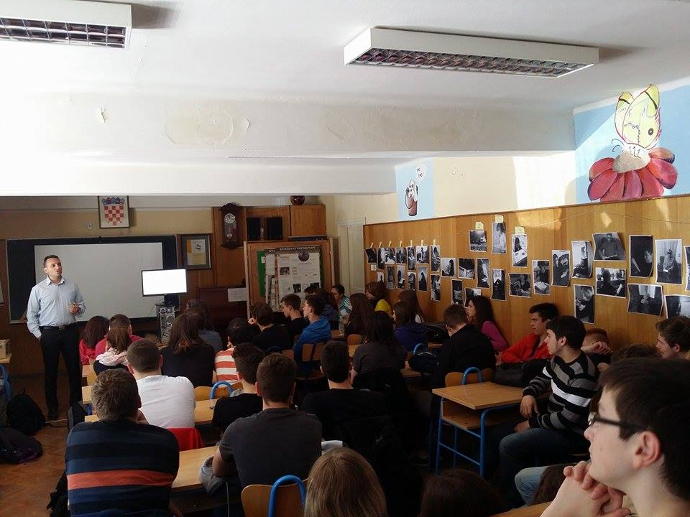
MSc Bernard Vukelić – Biometry and safer Internet, school library

Slide 14
Flipped classroom
1st grade students’ feedback
senior student Bruno Svetličić held PPT
Presentation at Dropbox
Presentation at Inspiring Science education
Student Ana Frković created her own visualisation of Svetličić's PPT
She drew viruses coming from the Trojan horse and causing damage to the title chain – a symbol of damage by a computer virus
The poster includes potential dangers such as gambling, paedophilia, false profiles, etc.)
https://www.dropbox.com/s/384sekfwozfqcvn/PREZENTACIJA-ZIS.ppt?dl=0
Idea: collaborative teaching and mutual cooperation between older and younger students.

Slide 15
presentation
Flipped classroom – older students teach younger

Slide 16
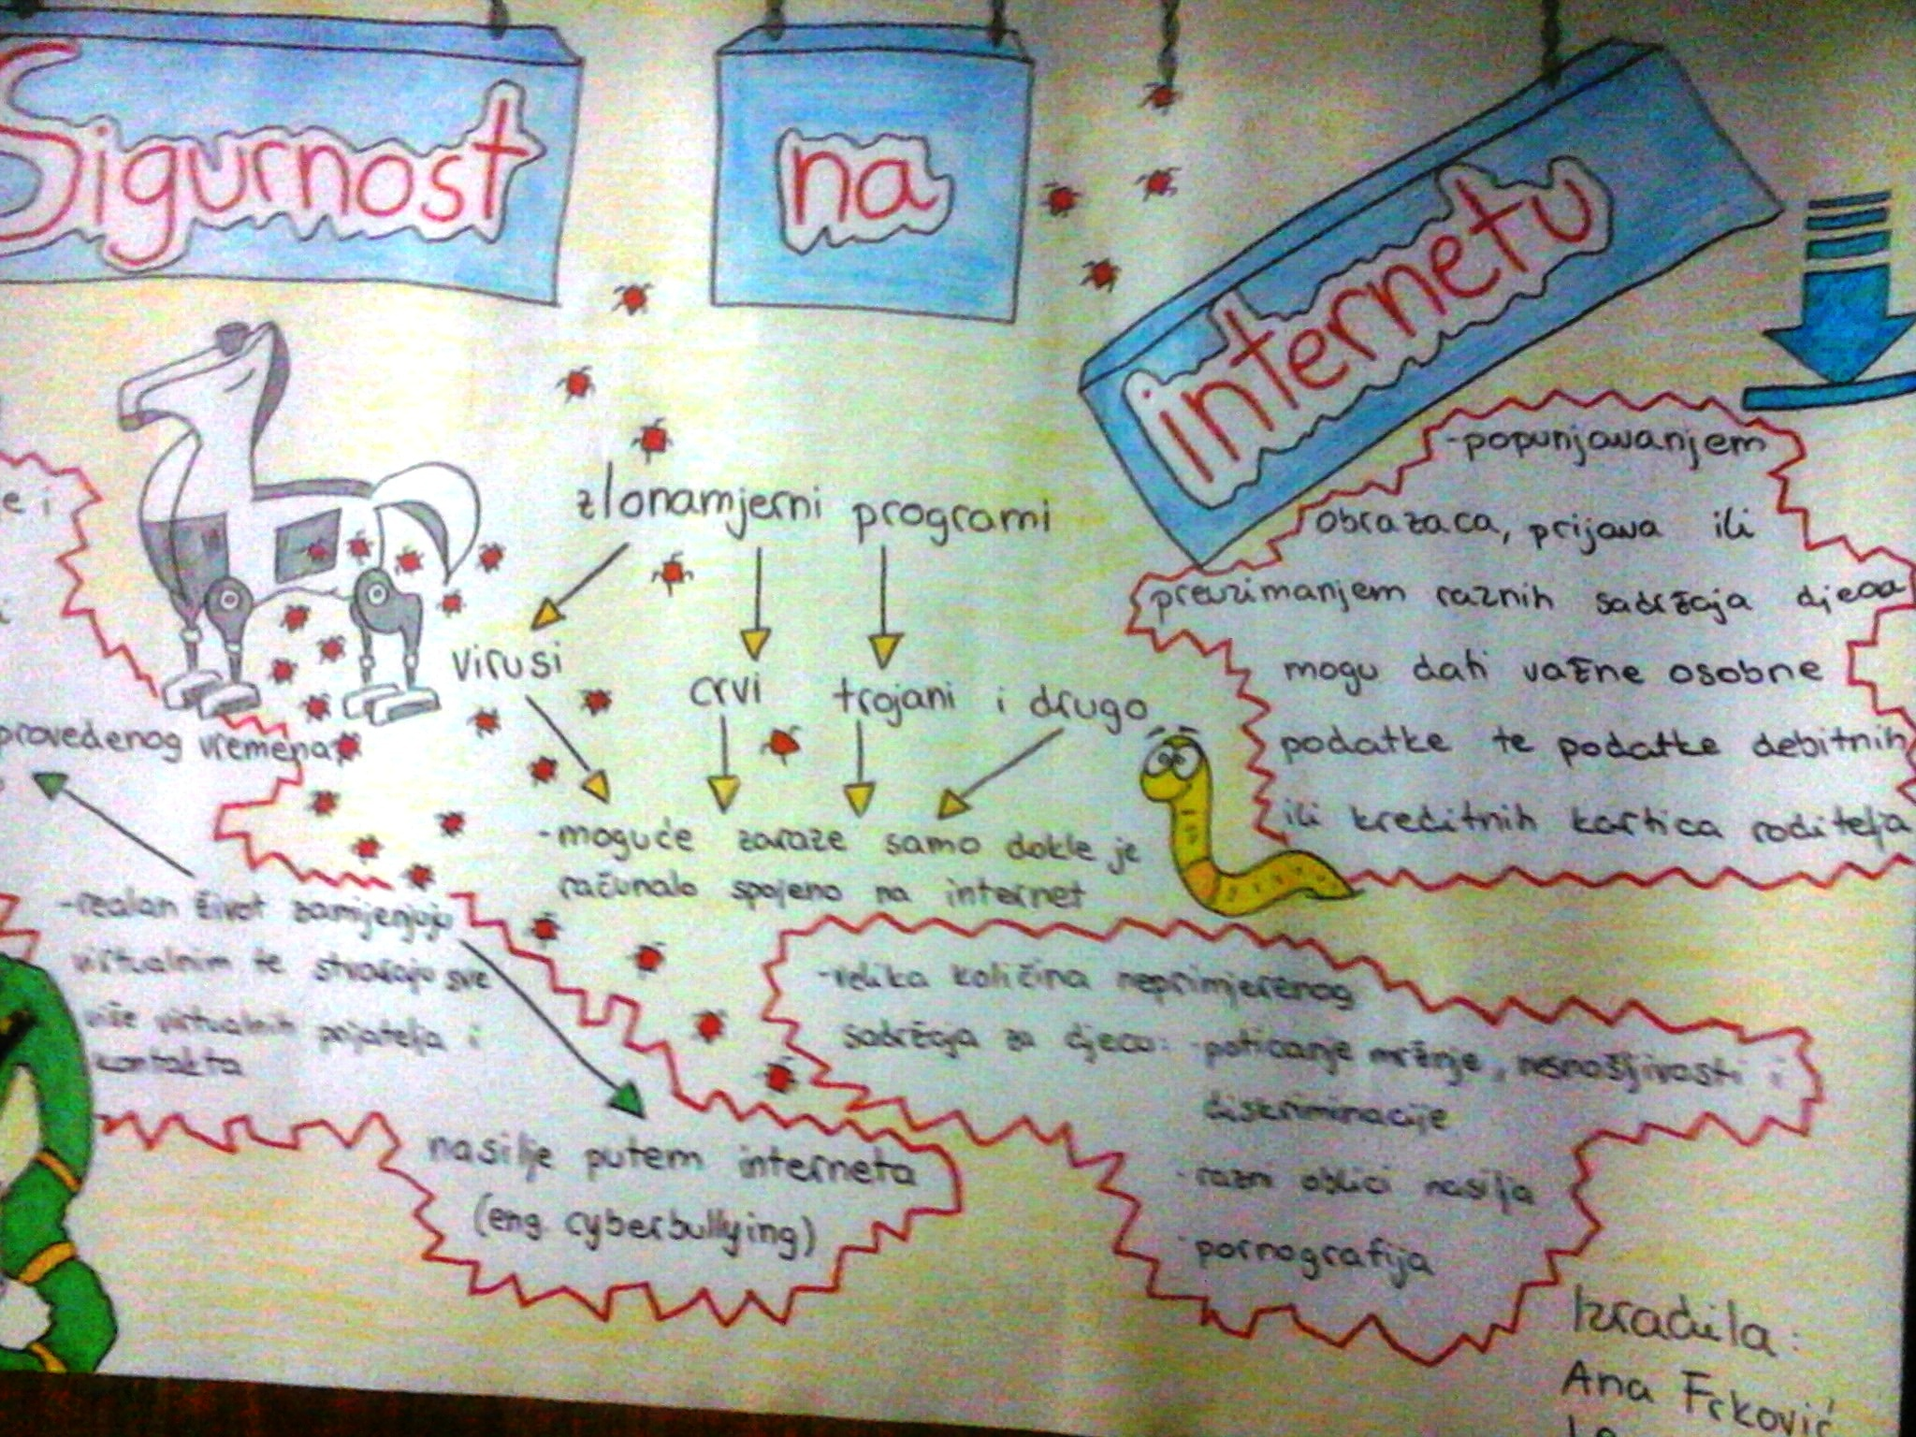
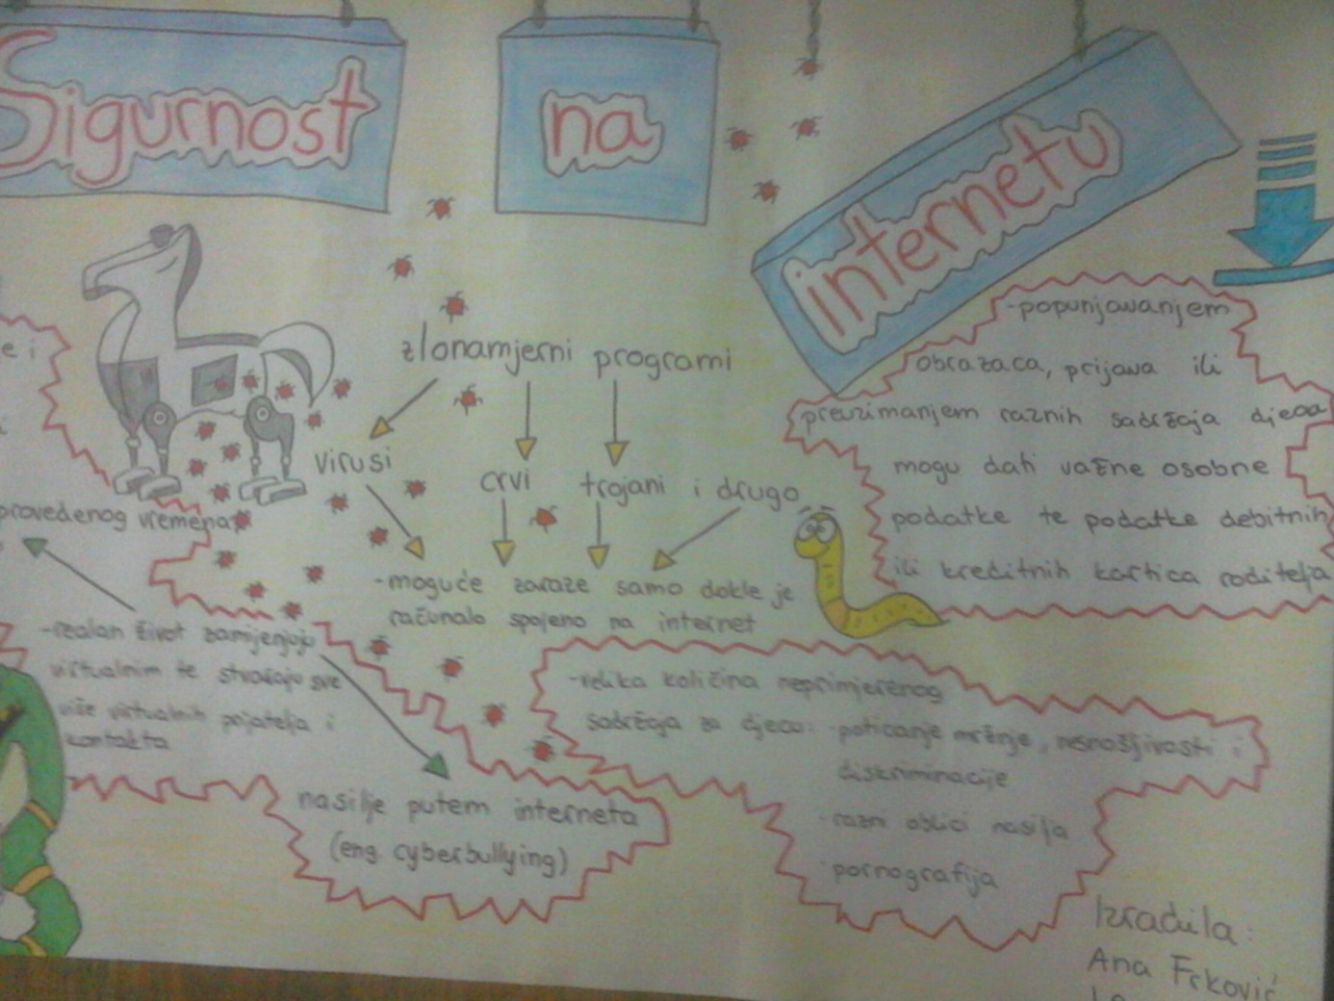
Ana’s poster - feedback

Slide 17
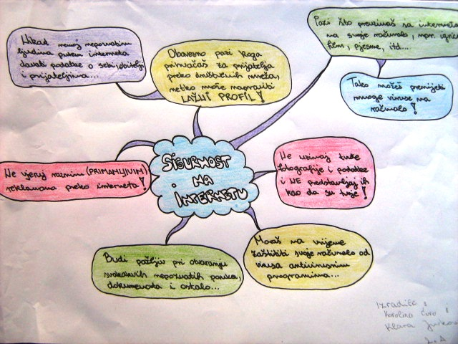
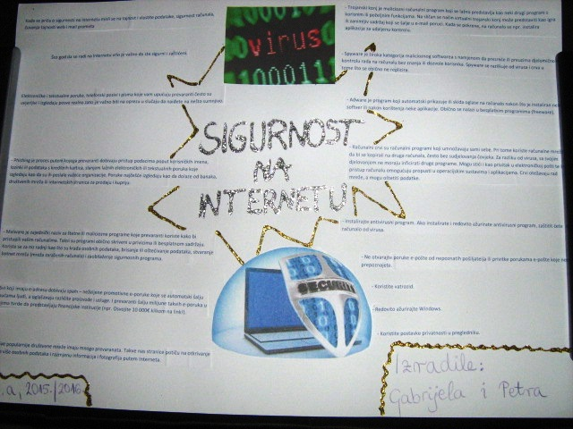
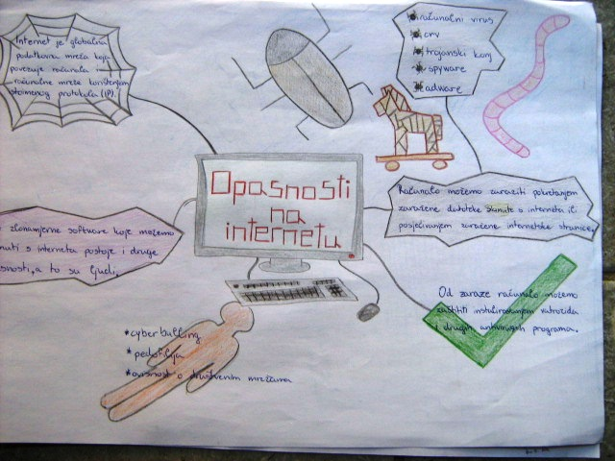
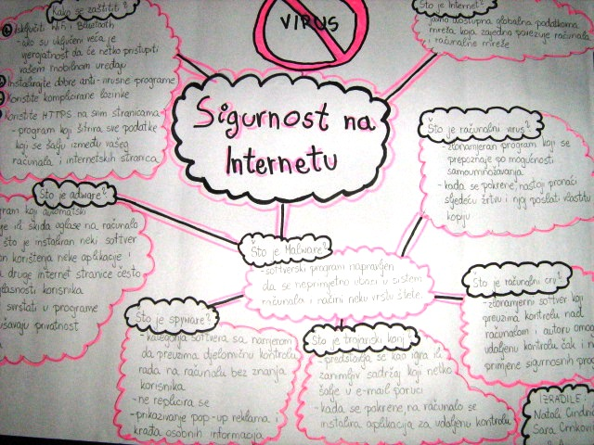
Mind maps 1st grade

Slide 18
Fun and learning comic workshop
Student Klara Kastner held „How to make a comic in Pixton” workshop
Participants: students and teachers
Topics:
Cyberbullying
Safer Internet
Identity theft

Slide 19
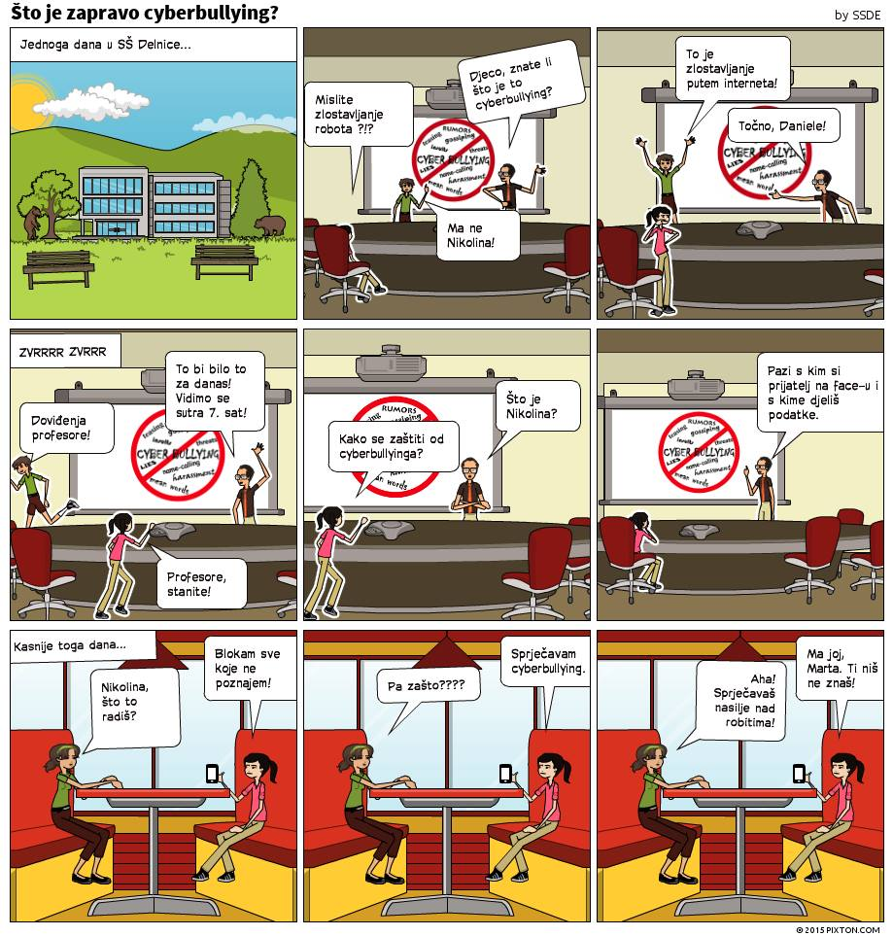
Cyberbullyng

Slide 20
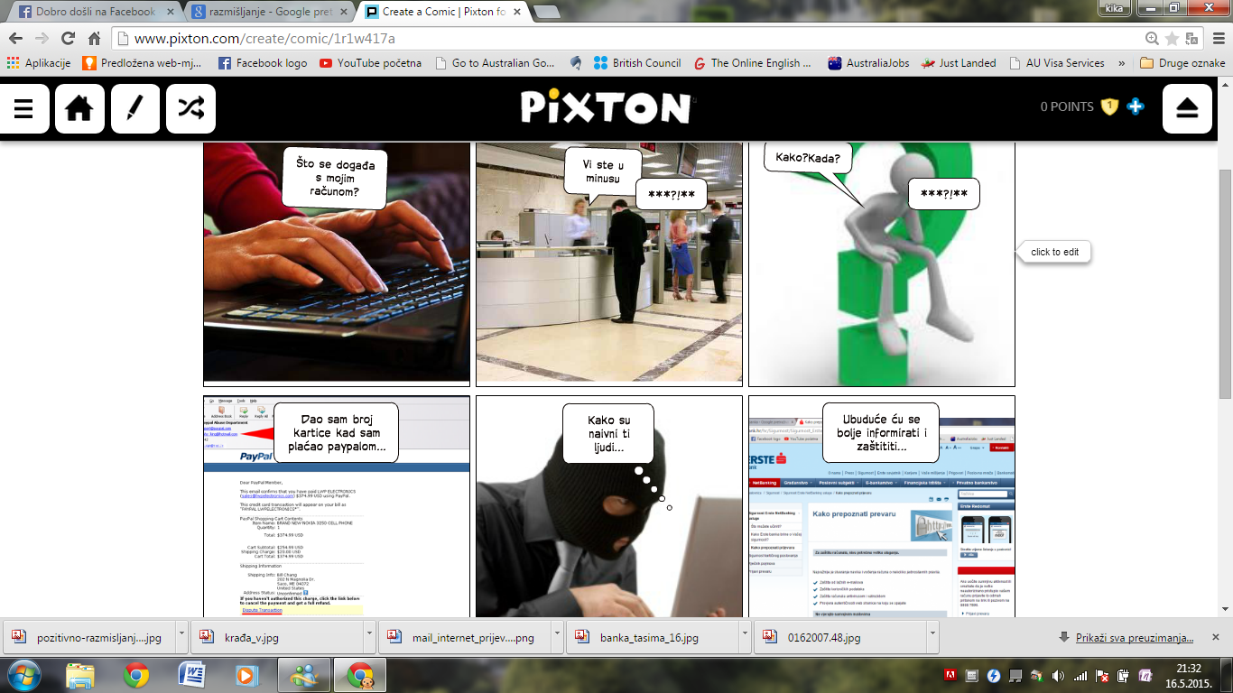
Identity theft

Slide 21
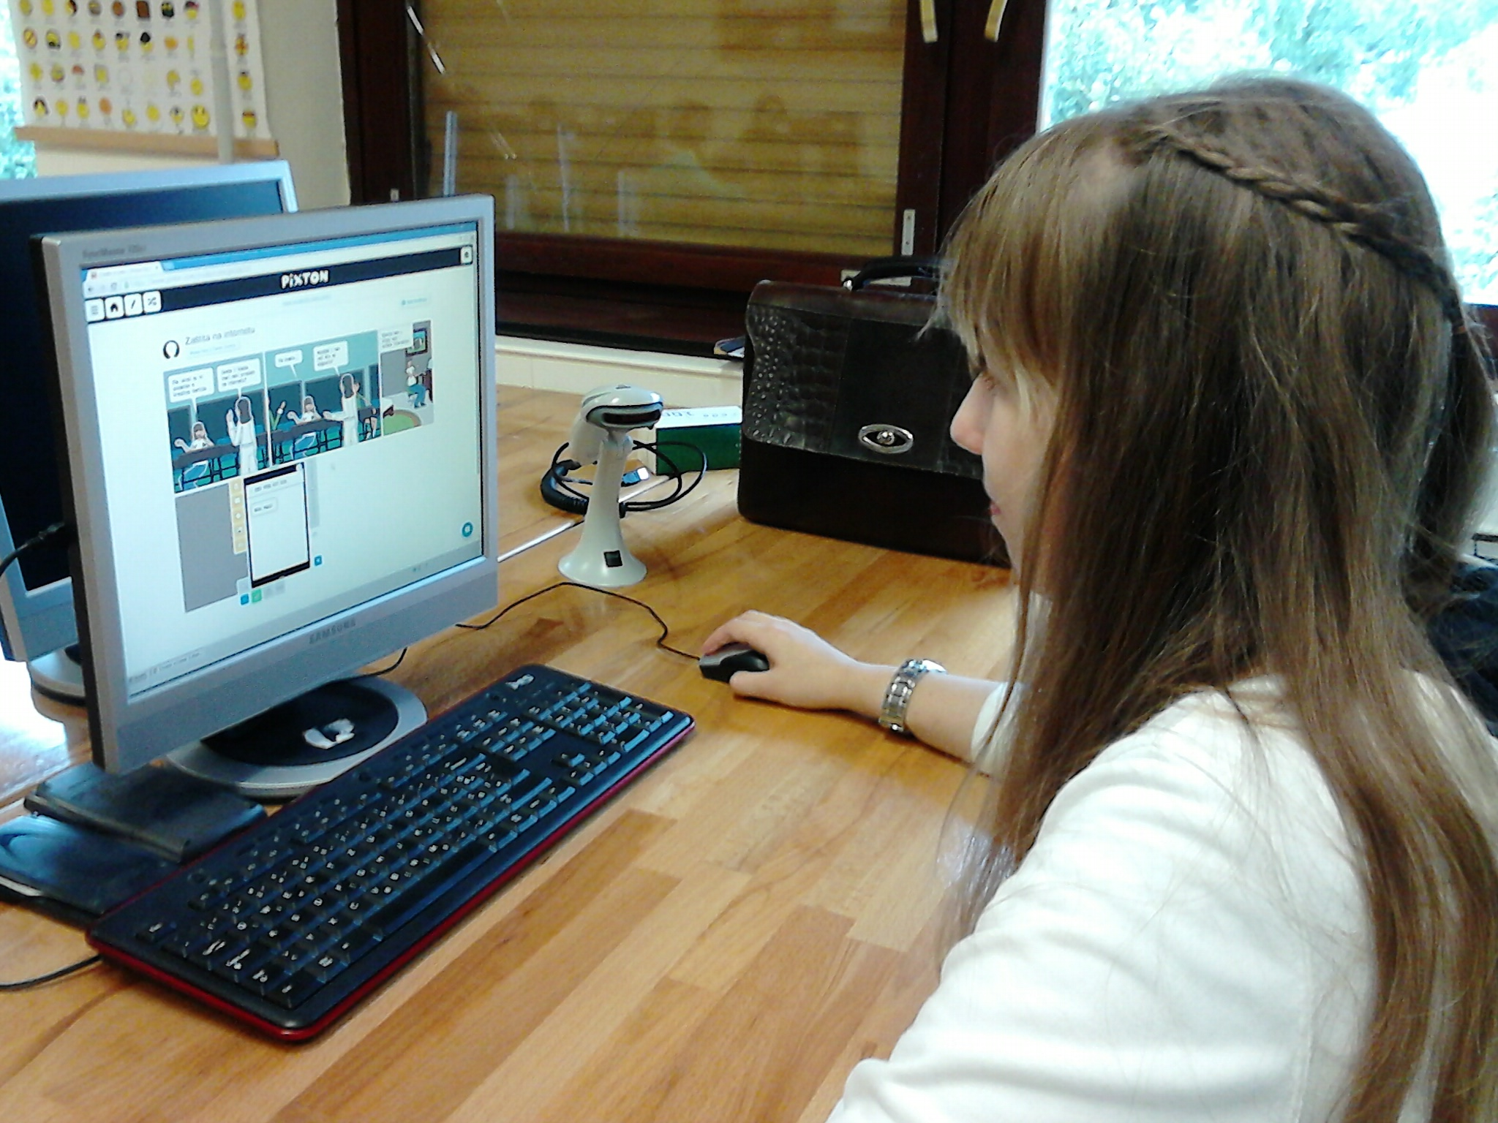
Klara during workshop

Slide 22
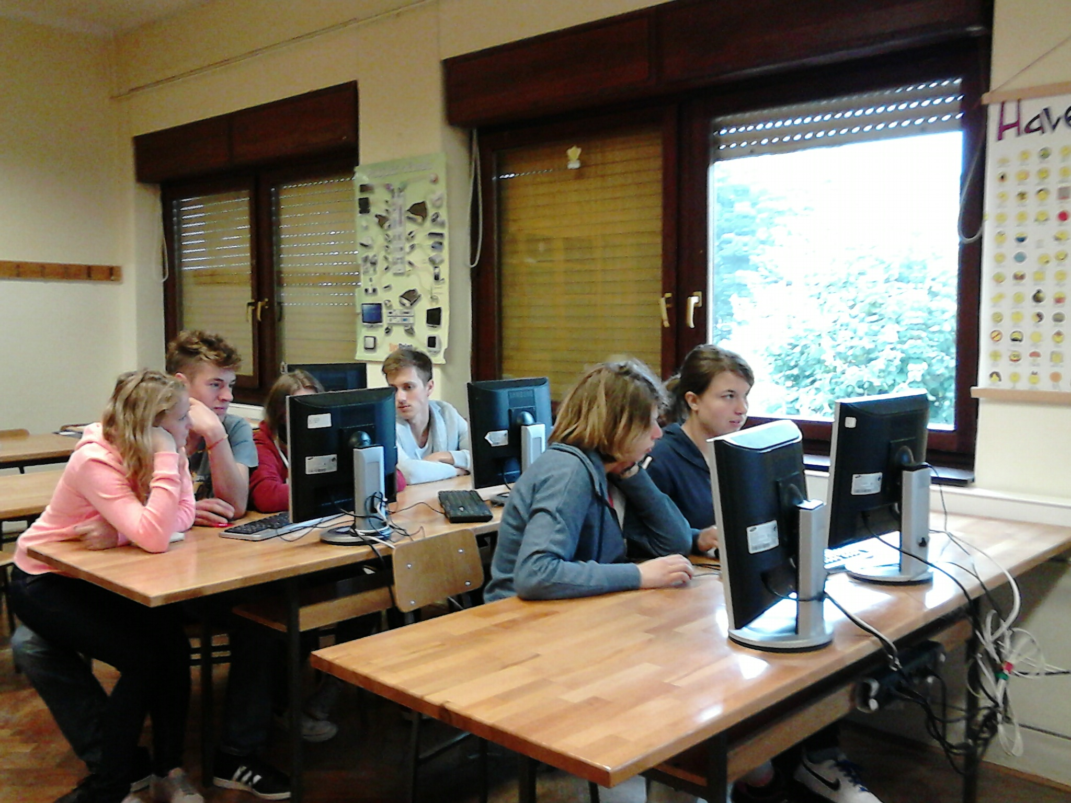
Group of students making their own comics

Slide 23
Valorisation
Valorisation – crossword puzzle
Mentors involved in the project created the crossword using the Internet safety key words and terminology
Crossword at Inspiring Science Education
file:///C:/Users/Korisnik/Documents/sigurnost%20na%20internetu/~TempJCrossPrint.htm
Workshop – who want’s more (share your experience) Mentors organized a workshop for the most curious students in order to further explain less known problems. The main goal of this particular workshop was to share students’ own experiences and openly talk about the potential dangers and unpleasant situations in our own community, especially the school itself, mostly involving Facebook, Twitter and Instagram.

Slide 24
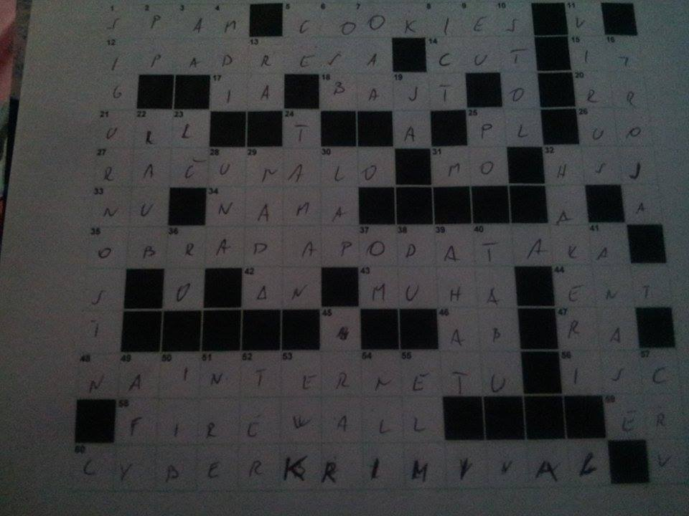
Solved crossword

Slide 25
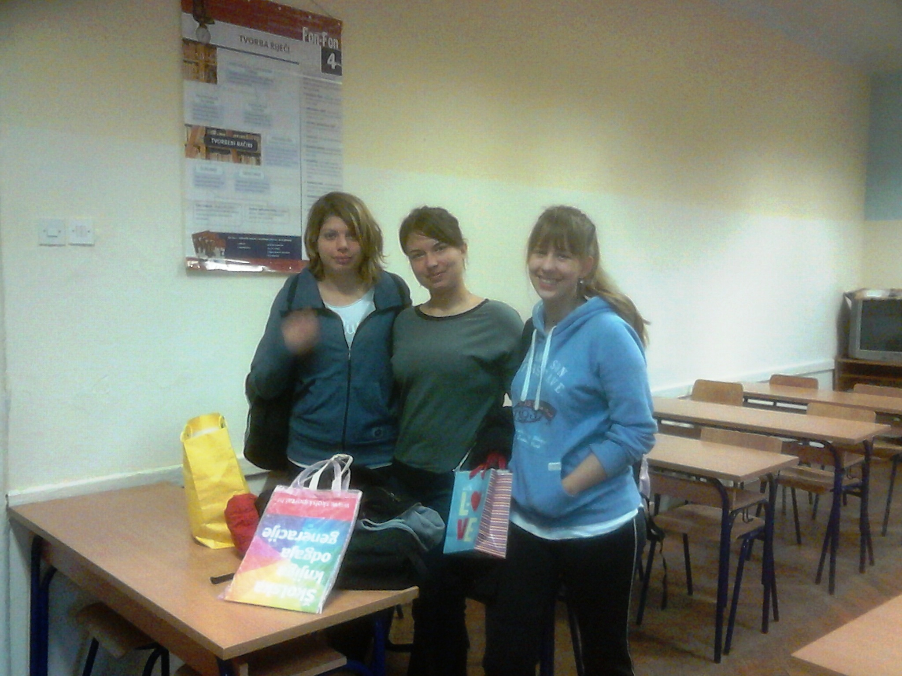
Reworded students
Rewarded students
Notes:
Reworded student

Slide 26
To be continued
The 3rd grade students created a short movie
Scrabble was used as a fun and innovative method to educate elementary school students
Goal: including students of different ages and providing them with the opportunity to teach and learn from each other
This phase is not the end of the project
YouTube video
https://www.dropbox.com/s/hlzcio97y0zq56x/MVI_1029.MOV?dl=0

Slide 27
Scrabble

Slide 28
Linoit
Project synergy in Linoit aplication

Slide 29
Safer Internet project-comic
Project synergy in Pixton aplication

Slide 30
Conclusions
main goal was not just the topic safer internet, we tried to put accent on the teaching methods: from university to high school, elementary school and kinder garden
Idea that older students teach younger ones
Warn students about real and potential dangers
Result of team work of many people and intersubject cooperation: Croatian language, citizenship education, IT, foreign language etc.
This project hasn’t finished because this topic is always present and it is necessary to talk, warn, speak and point out to our students the dangers of the Internet in every possible way

Slide 31
Thank you for your attention!
Questions?
Jasminka Lisac,prof.
jasminka.lisac@email.t-com.hr

